Slide 1
TRANSISTOR - Introduction
BIPOLAR JUNCTION TRANSISTOR
(BJT)

Slide 2
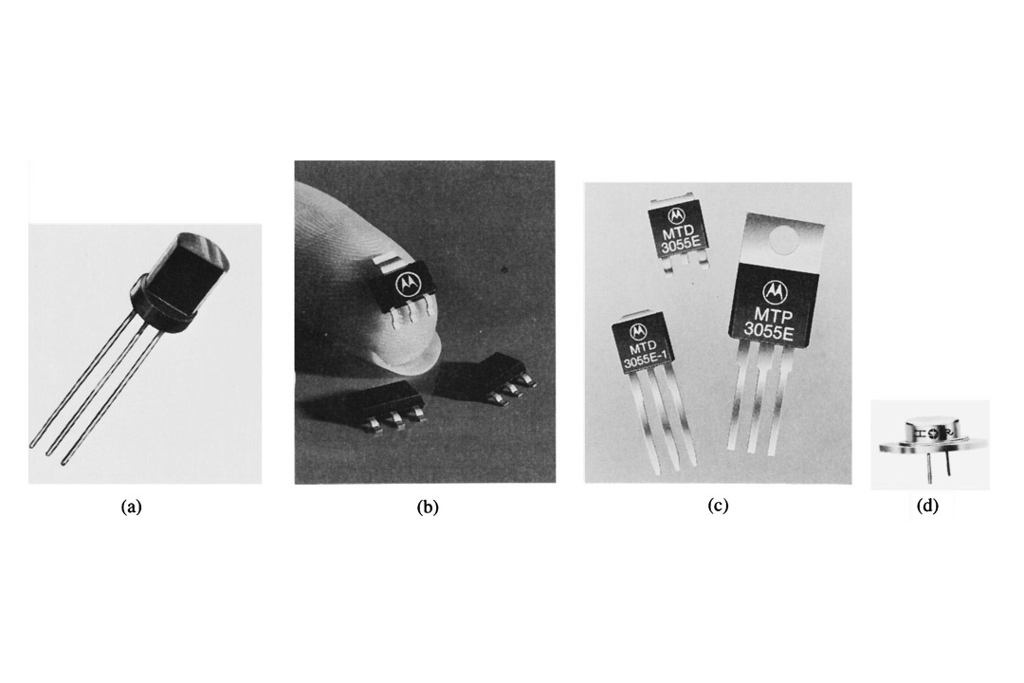
Introduction
Beside diodes, the most popular semiconductor devices is transistors. Eg: Bipolar Junction Transistor (BJT)
Transistors are more complex and can be used in many ways
Most important feature: can amplify signals and as switch
Amplification can make weak signal strong (make sounds louder and signal levels greater), in general, provide function called Gain

Slide 3
Transistor Structure
BJT is bipolar because both holes (+) and electrons (-) will take part in the current flow through the device
  N-type regions contains free electrons (negative carriers)
  P-type regions contains free holes (positive carriers)
2 types of BJT
  NPN transistor
  PNP transistor
The transistor regions are:
  Emitter (E) – send the carriers into the base region and then on to the collector
  Base (B) – acts as control region. It can allow none,some or many carriers to flow
  Collector (C) – collects the carriers

Slide 4
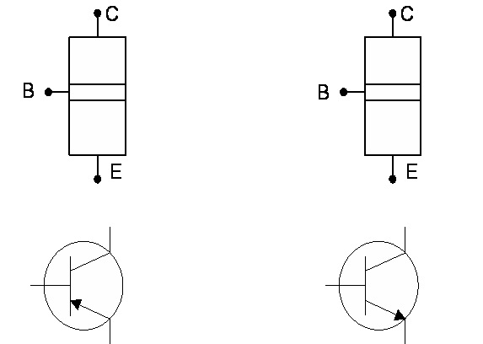
PNP and NPN transistor structure
P
N
N
P
P
N
I_{c}(mA)
I_{C}(mA)
I_{B}(µA)
I_{B}(µA)
I_{E}(mA)
I_{E}(mA)
Arrow shows the current flows

Slide 5
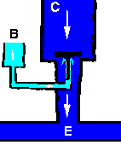
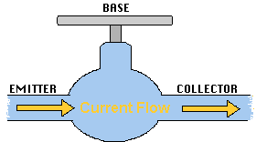
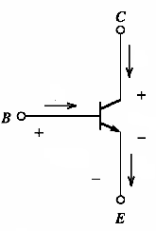
force – voltage/current
water flow – current
- amplification
Understanding of BJT

Slide 6
NPN Transistor Structure
The collector is lightly doped.
N
C
The base is thin and
is lightly doped.
P
B
The emitter is heavily doped.
N
E

Slide 7
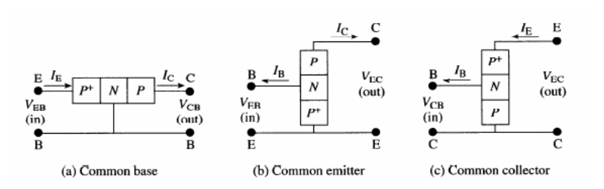
Transistor configuration
Transistor configuration –is a connection of transistor to get variety operation.
3 types of configuration:
  Common Collector.
  Common Base.
  Common Emitter

Slide 8
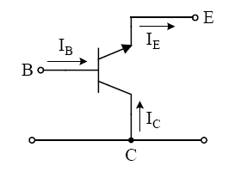
Common-Collector Configuration
The input signal is applied to the base terminal and the output is taken from the emitter terminal.
Collector terminal is common to the input and output of the circuit
Input – BC
Output – EC
Input = Output

Slide 9
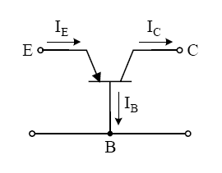
Common-Base Configuration
Base terminal is a common point for input and output.
Input – EB
Output – CB
Not applicable as an amplifier because the relation between input current gain (I_{E}) and output current gain (I_{C}) is approximately 1

Slide 10
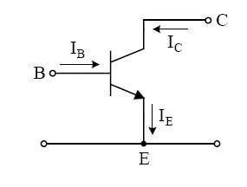
Common-Emitter Configuration
Emitter terminal is common for input and output circuit
Input – BE
Output – CE
Mostly applied in practical amplifier circuits, since it provides good voltage, current and power gain

Slide 11
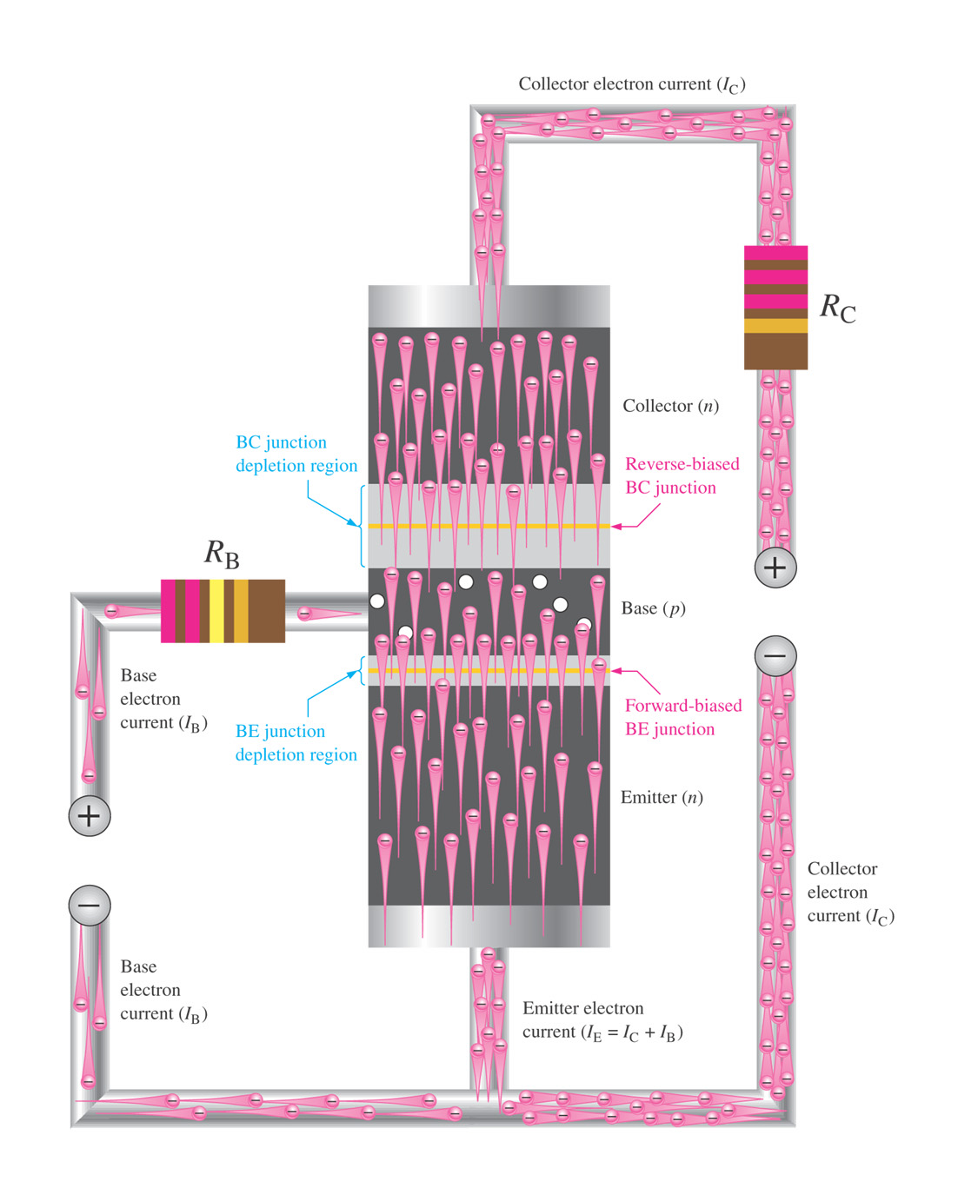
Figure 4–4 Illustration of BJT action.
Forward bias narrows the B-E depletion region
Reverse bias widens the B-C depletion region
For the B-C junction to be reverse biased, the Collector is made more +ve than the Base

Slide 12
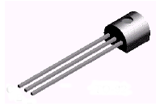
NPN Transistor Bias
No current flows.
N
C
The C-B junction
is reverse biased.
P
B
N
E

Slide 13
NPN Transistor Bias
N
C
P
B
The B-E junction
is forward biased.
N
E
Current flows.

Slide 14
NPN Transistor Bias
I_{C}
Current flows
everywhere.
N
C
P
B
When both junctions
are biased....
I_{B}
N
E
Note that I_{B} is smaller
than I_{E} or I_{C}.
I_{E}

Slide 15
I_{C}
Note: when the
switch opens, all
currents go to zero.
N
C
Although I_{B} is smaller
it controls I_{E} and I_{C}.
P
B
I_{B}
Gain is something small
controlling something large
(I_{B} is small).
N
E
I_{E}

Slide 16
I_{C} = 99 mA
The current gain from
base to collector
is called β.
C
I_{B} = 1 mA
P
B
99 mA
I_{C}
N
E
β =
= 99
I_{B}
1 mA
I_{E} = 100 mA

Slide 17
I_{C} = 99 mA
Kirchhoff’s
current law:
C
I_{B} = 1 mA
P
B
I_{E} = I_{B} + I_{C}
= 1 mA +
99 mA
N
E
= 100 mA
I_{E} = 100 mA

Slide 18
I_{C} = 99 mA
In a PNP transistor,
holes flow from
emitter to collector.
C
I_{B} = 1 mA
B
Notice the PNP
bias voltages.
E
I_{E} = 100 mA

Slide 19
Alpha (α) and Beta (β)
α measures the portion of the emitter current that “survives” after passage through the base to become collector current
  I_{C} = αI_{E}
β is the dc current gain of a transistor
  I_{C} = βI_{B}

Slide 20
NPN Schematic Symbol
Collector
Base
C
B
E
Emitter
Memory aid: NPN
means Not Pointing iN.

Slide 21
PNP Schematic Symbol
Collector
Base
C
B
E
Emitter

Slide 22
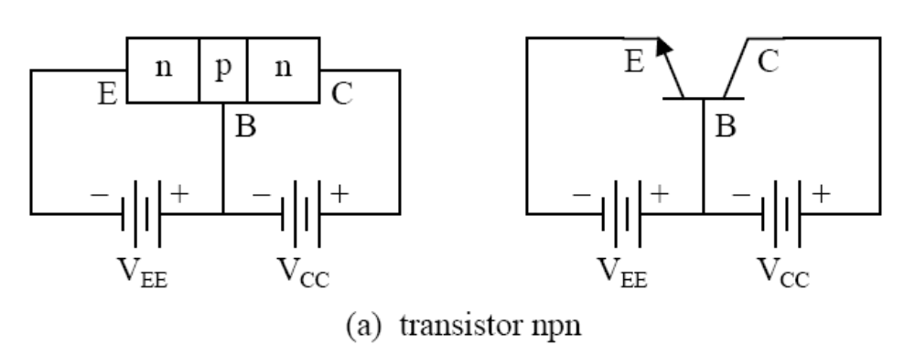
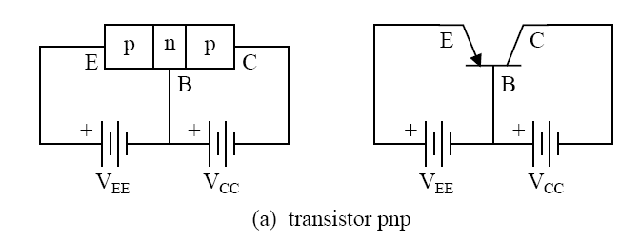
Recall: NPN and PNP Bias
Fundamental operation of pnp transistor and npn transistor is similar except for:
  role of electron and hole,
  voltage bias polarity, and
  Current direction

Slide 23
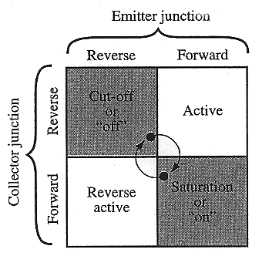
Modes of Operation
Cutoff – Both junctions are reverse biased and the transistor appears as an open switch.
Saturation – Both junctions are forward biased and the transistor appears as a closed switch.
These two bias conditions are important for digital circuits.

Slide 24
Modes of Operation
Active – The emitter junction is forward biased and the collector junction is reverse biased.
Reverse active – The emitter junction is reverse biased and the collector junction is forward biased.

Slide 25
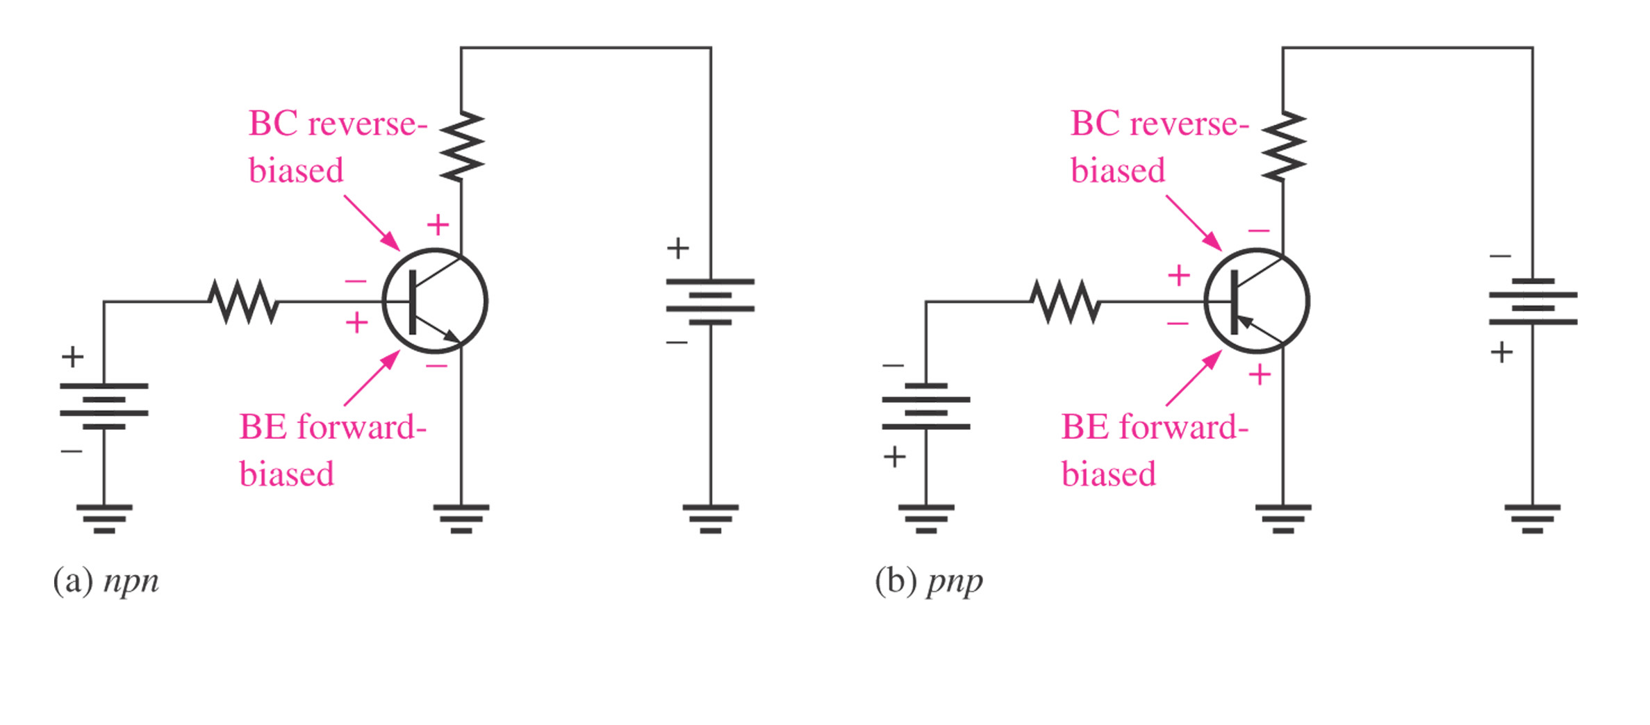
Forward-active operating mode

Slide 26
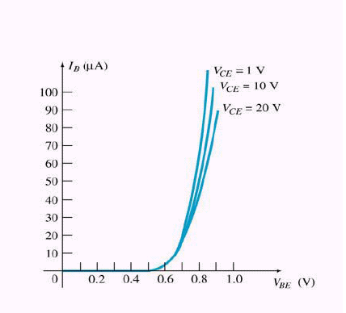
I-V Characteristic for CE configuration : Input characteristic
Input characteristic: input
current (I_{B}) against input
voltage (V_{BE}) for several output
voltage (V_{CE})
From the graph
  I_{B} = 0 A V_{BE} < 0.7V (Si)
  I_{B} = value V_{BE} > 0.7V (Si)
The transistor turned on when
V_{BE} = 0.7V

Slide 27
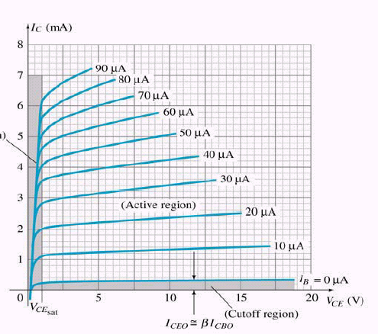
I-V Characteristic for CE configuration : Output characteristic
Output characteristic: output
current (I_{C}) against output
voltage (V_{CE}) for several
input current (I_{B})
3 operating regions:
  Saturation region
  Cut-off region
  Active region

Slide 28
I-V Characteristic for CE configuration : Output characteristic
Saturation region – in which both junctions are forward-biased and I_{C} increase linearly with V_{CE}
Cut-off region – where both junctions are reverse-biased, the I_{B} is very small, and essentially no I_{C} flows, I_{C} is essentially zero with increasing V_{CE}
Active region – in which the transistor can act as a linear amplifier, where the BE junction is forward-biased and BC junction is reverse-biased. I_{C} increases drastically although only small changes of I_{B.}
Saturation and cut-off regions – areas where the transistor can operate as a switch
Active region – area where transistor operates as an amplifier

Slide 29
Current Relationships
Relations between I_{C} and I_{E} :
α = I_{C}
I_{E}
Value of α usually 0.9998 to 0.9999, α ≈ 1
Relations between I_{C} and I_{B} :
  β = I_{C} @ I_{C} = βI_{B}
  I_{B}
Value of β usually in range of 50 →400
The equation, I_{E} =I_{C} + I_{B} can also written in β
I_{C} = βI_{B}
I_{E} = βI_{B} + I_{B} => I_{E} = (β + 1)I_{B}
The current gain factor , α and β is:
α = β @ β = α .
β + 1 α - 1

